Slide 1
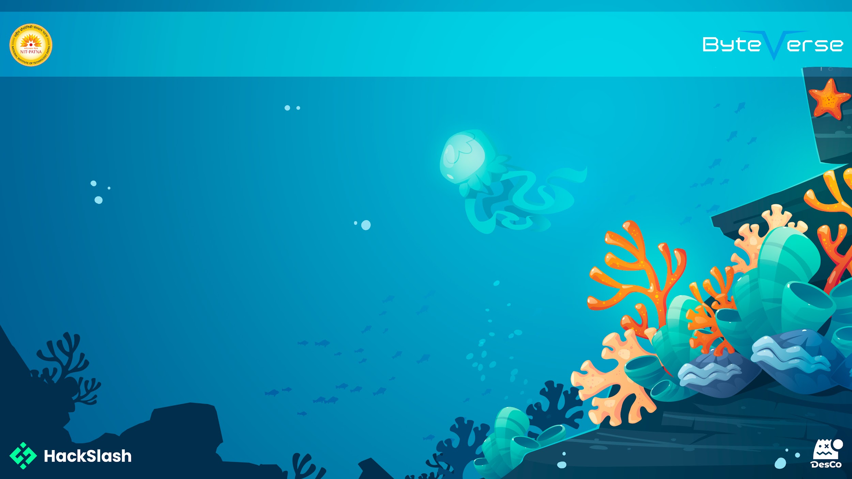
Basic Details of the Team
and Problem Statement
Problem Statement: A live disaster aid platform connecting victims, volunteers, and NGOs in real-time.
Team Name: JBL Speakers
Institute Name: National Institute of Technology, Patna
Theme Name: Disaster Management

Slide 2

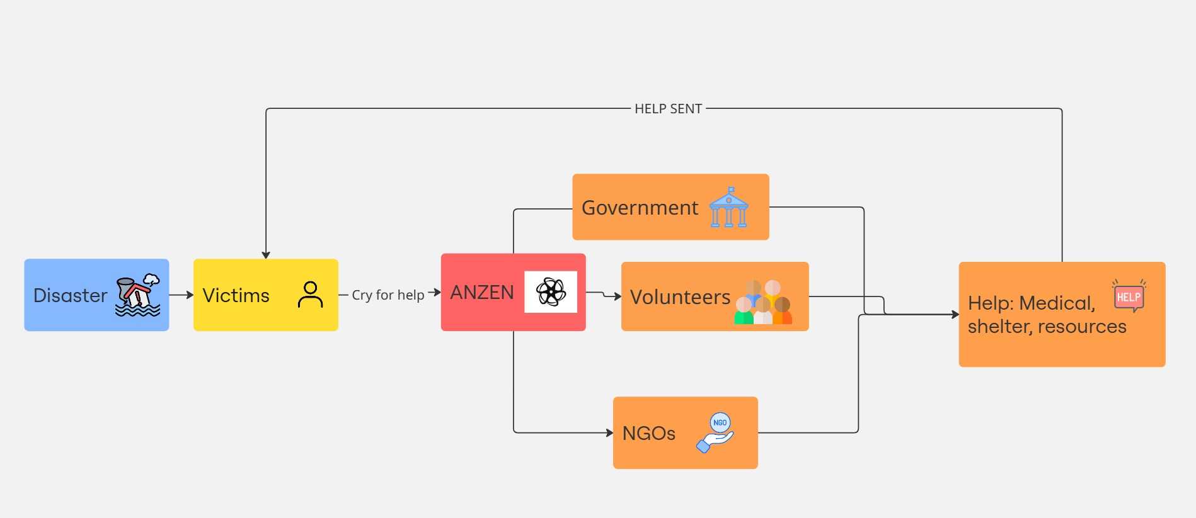
Idea/Approach Details
Describe your idea/Solution/Prototype here:
Anzen is a web-based disaster response platform connecting victims, volunteers, and NGOs.
Victims can report disasters and request help for essentials like food, shelter, medical aid, and more.
Individuals can offer assistance by donating money, providing shelter, or supplying resources.
NGOs can register to participate in relief efforts and coordinate aid more efficiently.
Includes a live interactive map showing real-time disaster zones and reported issues.
Built for scalability, accessibility, and impact in both urban and rural regions.
AI chatbot to help victims in real time by providing them safety measures.
AI disaster predictor, that predicts the probability of a disaster to hit a particular region.
Describe your Technology stack here:
HTML
CSS
JavaScript
Node.js
MongoDB
Python

Slide 3
Idea/Approach Details
Describe your Use Cases here:
Victims: People caught in disaster-hit areas can submit help requests for food, shelter, medical aid, or rescue using the platform’s simple reporting system.
Volunteers: Citizens can browse active help requests and contribute directly by offering shelter, donating supplies, or transferring funds.
NGOs: Verified NGOs can register, view help requests, and coordinate large-scale aid efforts in real-time using the live disaster map and user reports.
Authorities: Officials can monitor disaster zones and resource needs using the live map to make informed decisions for rapid deployment.
Awareness: Anyone can view the current state of disasters on the map and spread awareness via social sharing tools, increasing visibility and support.
Describe your Dependencies/ Show Stopper here:
Real time location access: Accurate disaster reporting and visualization require access to geolocation APIs and permissions from the user/device.
Internet Connection: The platform depends on internet access, which may be unavailable or unstable in disaster-struck areas—potentially limiting usage where it’s needed most.
NGO verification system: A secure and trustworthy process for verifying NGOs and aid providers is essential to prevent misuse and ensure legitimacy.
User participation: The system relies on crowdsourced data. A lack of user engagement during critical times may hinder effectiveness.
Map APIs: The platform depends on external map services. Any service disruption or usage limit hit could affect the disaster map functionality.
AI chatbot: Provides safety methods
AI disaster predictor: Guesses the chance of a disaster

Slide 4
Team Member Details
Team Leader Name: Nimish Gupta
Branch (Btech/BCA etc): Btech Stream (ECE, CSE etc): CSE Year: 2024-28 Year (I,II,III,IV): I
Team Member 1 Name: Kumar Vaibhav
Branch (Btech/BCA etc): Btech Stream (ECE, CSE etc): CSE Year: 2024-28
Year (I,II,III,IV): I
Team Member 2 Name: Harsh Raj
Branch (Btech/BCA etc): Btech Stream (ECE, CSE etc): CSE Year: 2024-28
Year (I,II,III,IV): I
Team Member 3 Name: Naitik Raj
Branch (Btech/BCA etc): Btech Stream (ECE, CSE etc): CSE Year:2024-28
Year (I,II,III,IV): I

